Slide 1
Multi-Agent Communication
李志圆
2022.1.18

Slide 2
目录
背景介绍
相关工作
目前思路

Slide 3
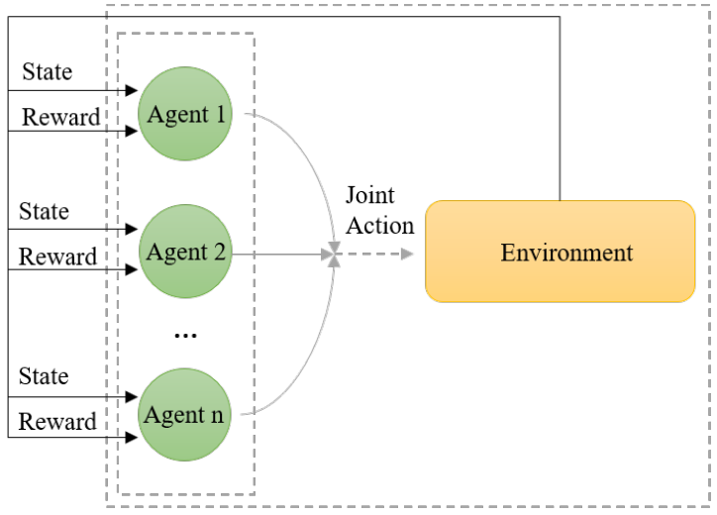
背景介绍
Learn to Communicate
Multiple agents interacting with the same environment.
Non-stationarity
Partial observability
Notes:
与单个代理设置相比，控制多个代理带来了一些额外的挑战，例如代理的异构性、如何确定合适的集体目标或需要设计紧凑表示的大量代理的可伸缩性，以及更重要的非平稳性问题。
在单代理环境中，代理只关心其自身操作的结果。在多智能体领域中，智能体不仅观察自身行为的结果，还观察其他智能体的行为。
代理之间的学习是复杂的，因为所有代理都可能相互交互并同时学习。多个代理之间的交互不断地重塑环境并导致非平稳性。
在这种情况下，代理之间的学习有时会导致代理策略的变化，并可能影响其他代理的最优策略。
在现实世界的应用中，有许多情况下，代理只能部分观察环境。换句话说，当代理与环境交互时，它们不知道与环境相关的状态的完整信息。
在这种情况下，代理观察到有关环境的部分信息，并需要在每个时间步骤中做出最佳决策。这类问题可以使用部分可观测马尔可夫决策过程（POMDP）建模。

Slide 4
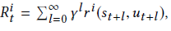
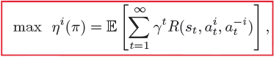
背景介绍
Dec-POMDP
<N,A,O,T,R,P_{o},γ>
where
information states
Stochastic transition model
Policy
Cumulative reward
Target
Notes:
调查沟通的共同框架是dec POMDP（Oliehoek和Amato 2016），这是一种完全合作的环境，在这种环境中，代理感知到对环境的部分观察，并试图改善平等分享的回报。在这样的分布式系统中，代理不仅要学习如何合作，还要学习如何通信，以优化共同目标。
DecPOMDP可以用元组来描述
我们假设每个时间步的隐藏信息状态都是从未知分布中采样的,公共状态从最初的分发Po演变而来
在协作环境中，假定每个代理追求共享的最大累积报酬

Slide 5
背景介绍
Communication
Explicit communication channels
[Baker et al. 1999; Roth, Simmons, and Veloso 2006]
conceptually resemble language or verbal communication
additional computational and memory costs
Implicit communication
[Rasouli, Kotseruba, and Tsotsos 2017; Rabinowitz et al. 2018]
infer the implicit meaning behind others’ actions
theory of mind
Notes:
能够开发通信和语言语料库的代理是机器智能的一个重要挑战（Kirby 2002）。智能代理不仅必须决定通信内容，还必须决定何时以及与谁通信。通讯的语言必须建立在共识的基础上，以便所有代理都能理解其语义。学习通讯的研究工作已有很多，因为将通讯融入到代理中可以克服许多弊端，包括非平稳性、代理之间的协调一致性和部分可观察性。例如，当一个代理知道其他代理采取的行动时，学习问题从一个代理的角度在完全可观察的环境中再次变得平稳。通过通讯将本地观察结果传达给其他参与者，有助于弥补有限的知识

Slide 6
目录
背景介绍
相关工作
目前思路

Slide 7
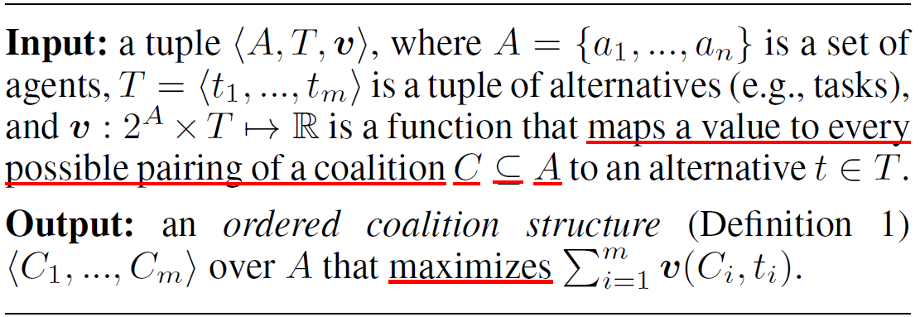
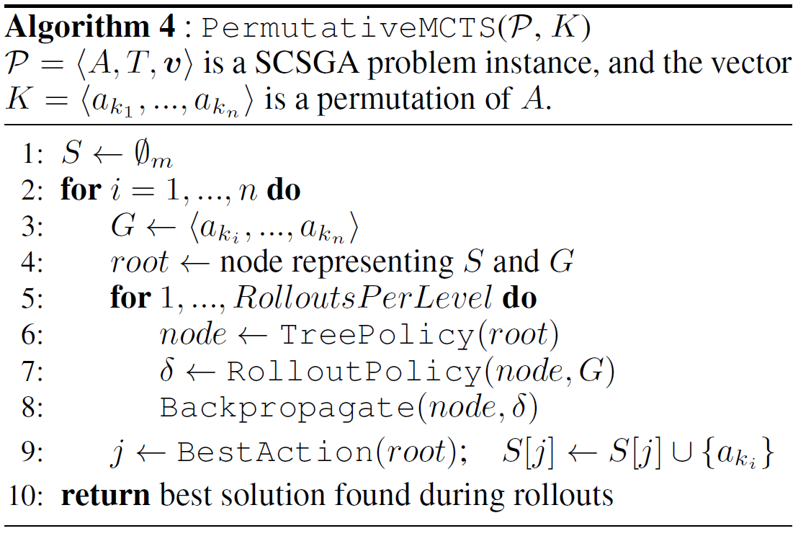
相关工作
Coalition Structure Generation
Problem definition
Monte Carlo tree search
Fredrik Prantare, Herman Appelgren and Fredrik Heintz. Anytime Heuristic and Monte Carlo Methods for Large-Scale Simultaneous Coalition Structure Generation and Assignment. AAAI-21.

Slide 8
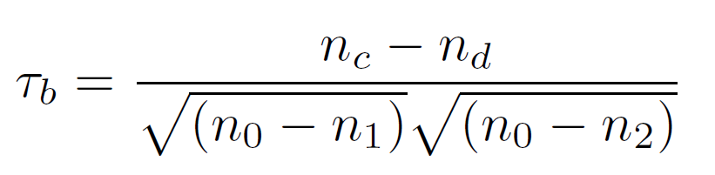
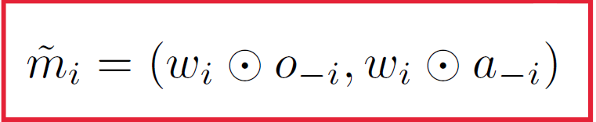
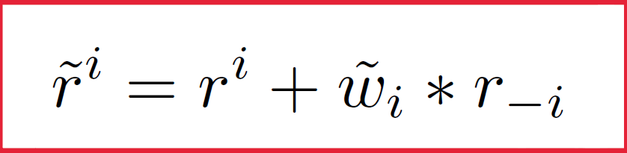
相关工作
Correlation Between Individual Agents
Intuition
The changes in the received rewards of agents reflect the correlation between agents to a certain extent.
Kendall Correlation
Message Dropout & Reward Shaping
Yang Zhang, Qingyu Yang, Dou An, Chengwei Zhang. Coordination Between Individual Agents in Multi-Agent Reinforcement Learning. AAAI-21.
Notes:
基于奖励轨迹，有一种简单的推理技术来分析代理之间的相关性。
在代理人和环境互动的训练中，奖励轨迹ri=fri1；ri2；：；获得每个代理i的ritg。代理人所获报酬的变化在一定程度上反映了代理人之间的相关性。
一个简单的推论是，如果两个代理的报酬同时增加或减少，那么这两个代理更有可能成为具有合作关系的队友。相反，如果一个代理的报酬增加而另一个代理的报酬减少，那么两个代理更有可能处于竞争关系中。

Slide 9
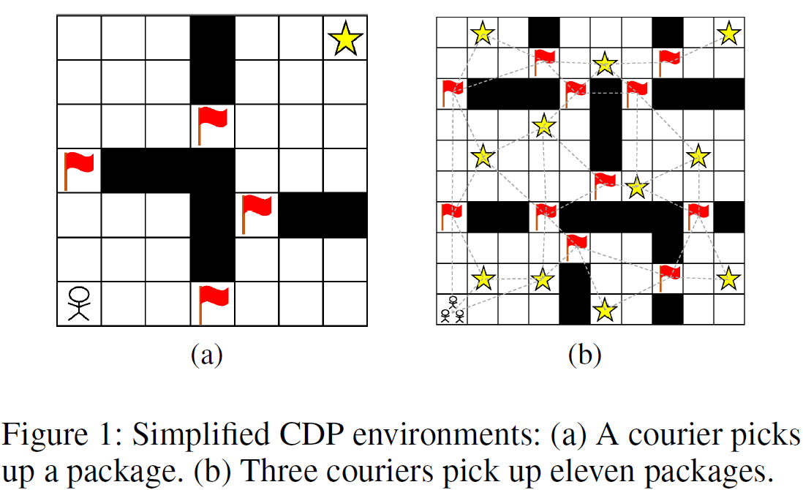
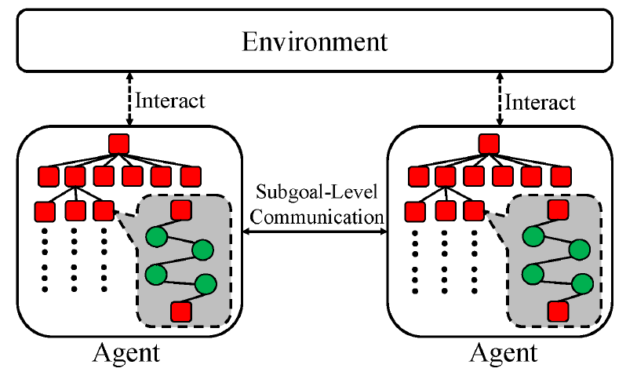
相关工作
Sub-Goal Tree Search
Intuition
It is either too coarse such as final goals or too fined as primitive steps, which is inefficient due to the lack of modularity and semantics.
Minglong Li, Zhongxuan Cai,Wenjing Yang, Lixia Wu, Yinghui Xu, Ji Wang. Decentralized Sub-Goal Tree Search for Multi-Agent Coordination. AAAI-21.

Slide 10
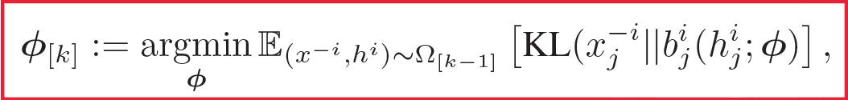
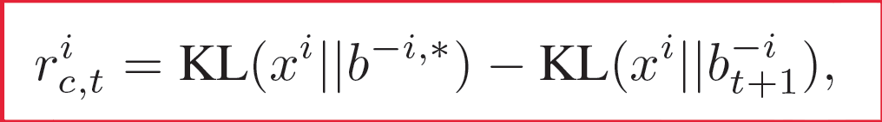
相关工作
Communicate Implicitly
Intuition
Human collaborators act by learning to infer meaning behind their partner’s actions.
Explicit communication channels come at additional computational and memory costs.
Policy Belief Learning
Auxiliary Reward Signal
Zheng Tian, Shihao Zou, Ian Davies, Tim Warr, LishengWu, Haitham Bou Ammar, Jun Wang. Learning to Communicate Implicitly by Actions. AAAI-20.

Slide 11
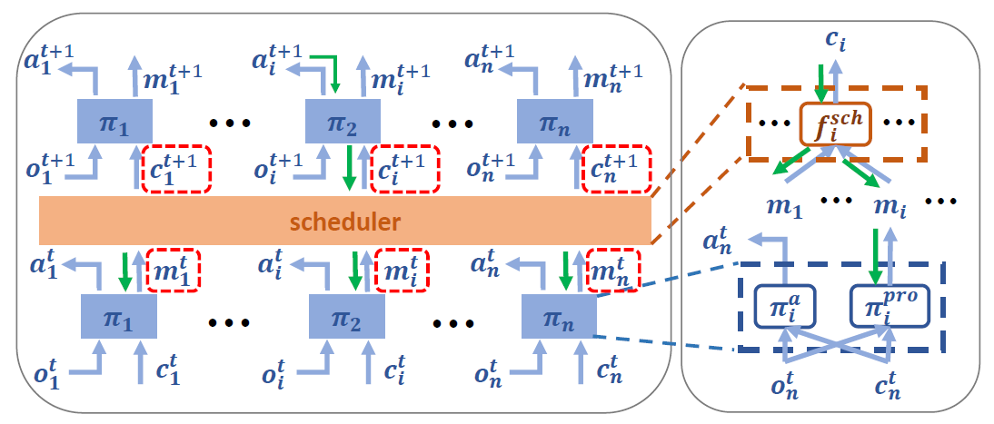
相关工作
Information Bottleneck
Intuition
Limited bandwidth constraint requires low-entropy messages throughout the transmission.
Rundong Wang Xu He Runsheng Yu Wei qiu Bo An Zinovi Rabinovich. Learning Efficient Multi-agent Communication: An Information Bottleneck Approach. ICML-20.

Slide 12
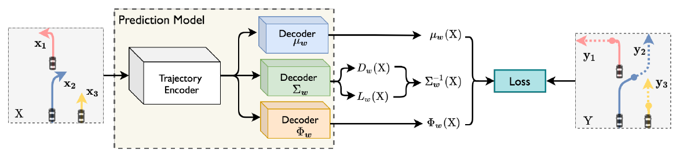
相关工作
Collaborative Uncertainty
Intuition
To better predict the future trajectories of multiple agents, recent works have introduced interaction modules to capture interactions among agents. This approach leads to correlations among the predicted trajectories. However, the uncertainty brought by such correlations is neglected.
Collaborative Uncertainty
Bohan Tang. Collaborative Uncertainty in Multi-Agent Trajectory Forecasting. NIPS-21.

Slide 13
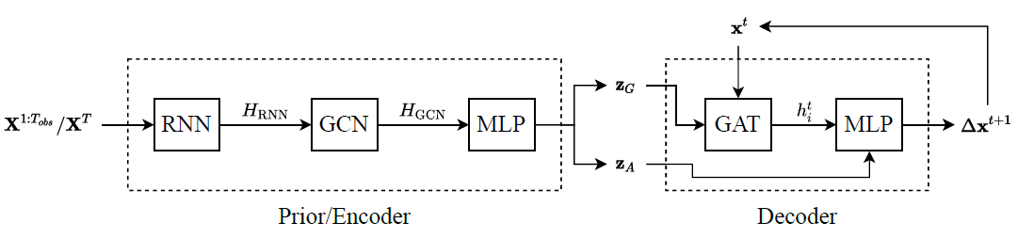
相关工作
Intra- & Inter-
Intuition
To better predict the future trajectories of multiple agents, recent works have introduced interaction modules to capture interactions among agents. This approach leads to correlations among the predicted trajectories. However, the uncertainty brought by such correlations is neglected.
Intra-agent intention & Inter-agent relations
Longyuan Li. Generative Relation and Intention Network for Multi-agent Trajectory Prediction. NIPS-21.

Slide 14
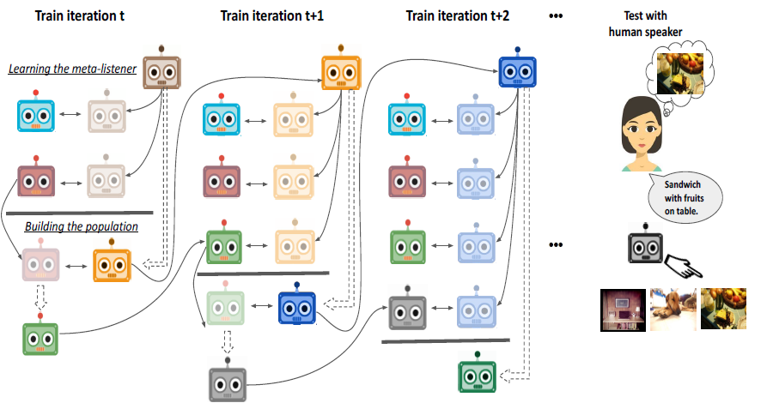
相关工作
Population-based
Intuition
The goal is to train agents that can coordinate with seen, unseen as well as human partners in a multi-agent communication environment involving natural language.
Dynamic Population-based Meta-Learning
Abhinav Gupta. Dynamic population-based meta-learning for multi-agent communication with natural language. NIPS-21.

Slide 15
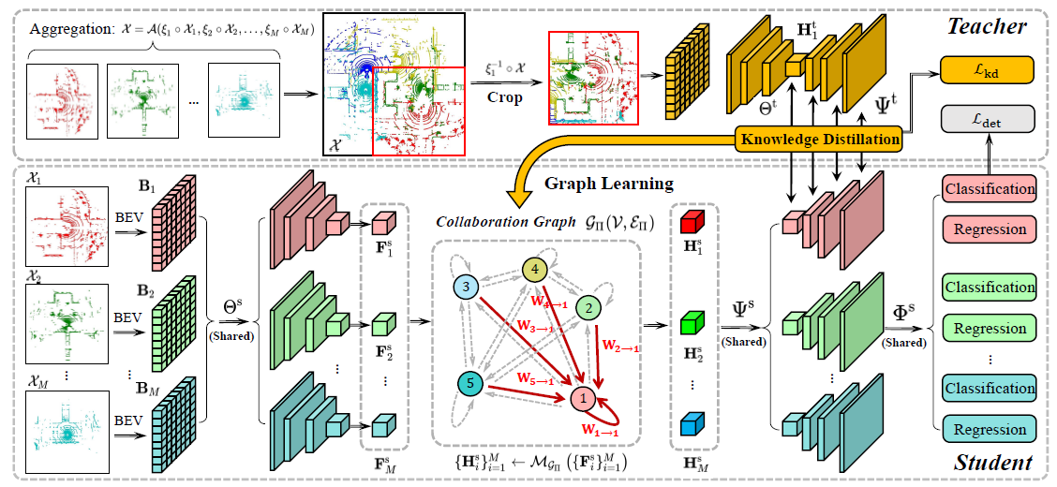
相关工作
Knowledge Distillation
Intuition
Promote better performance-bandwidth trade-off for multi-agent perception.
Distilled Collaboration Graph
Yiming Li. Learning Distilled Collaboration Graph for Multi-Agent Perception. NIPS-21.

Slide 16
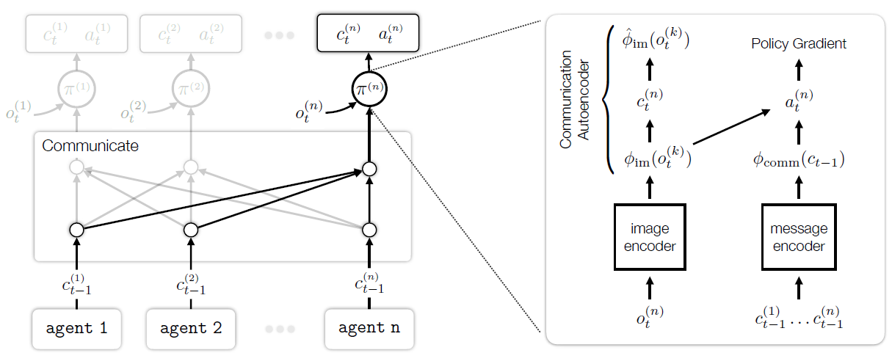
相关工作
Speaker Listener Module.
Intuition
Ground language in learned representations.
Grounding Representation for Communication with Autoencoders
Toru Lin. Learning to Ground Multi-Agent Communication with Autoencoders. NIPS-21.

Slide 17
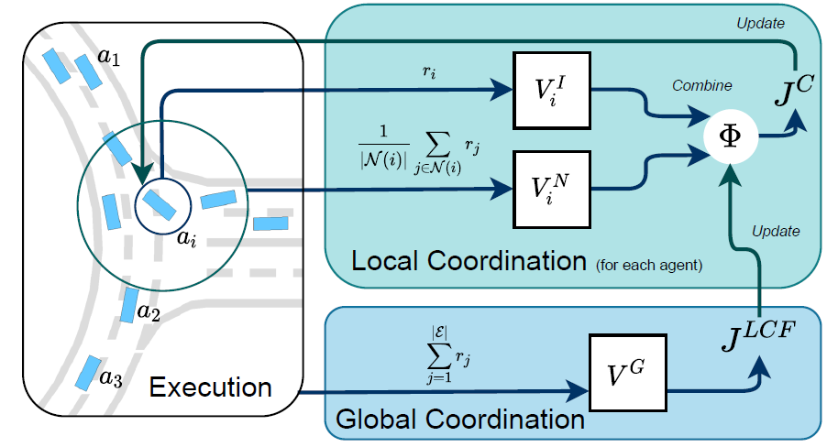
相关工作
Local & Global Coordination
Intuition
Interactions of agents are time-varying and the environment is non-stationary.
Coordinated Policy Optimization
Zhenghao Peng. Learning to Simulate Self-Driven Particles System with Coordinated Policy Optimization. NIPS-21.

Slide 18
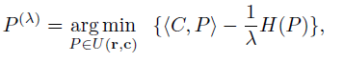
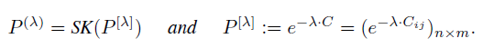
相关工作
Optimal Transport
Intuition
Interpret cooperative communication as a problem of optimal transport.
Cooperative communication as a problem of optimal transport
the teacher selects data and the learner draws inferences based on those data.
Optimal transport provides a mathematical framework for formalizing movement of one distribution to another, and therefore a framework for modeling communication.
PeiWang. A mathematical theory of cooperative communication. NIPS-20.

Slide 19
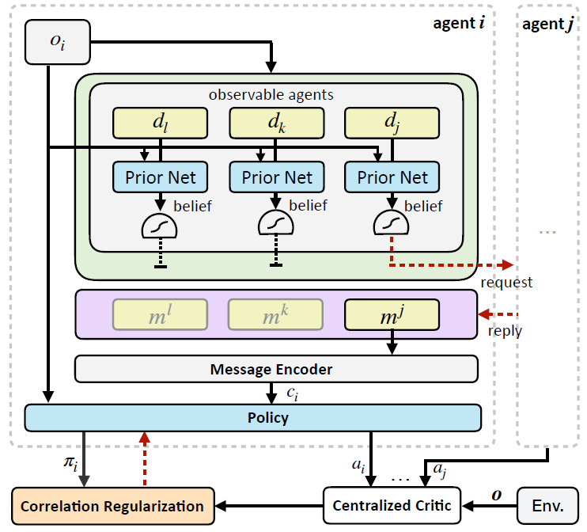
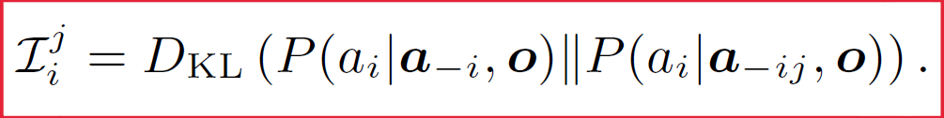
相关工作
Causal Effect
Intuition
Humans would use their prior knowledge to choose whom to communicate with.
Individually Inferred Communication
The influence of one agent on the other is captured by the causal effect of the agent’s action on the other’s policy. For any agent that can cause drastic change to the other’s policy, that agent is considered as relevant and influential.
Ziluo Ding Tiejun Huang Zongqing Lu. Learning Individually Inferred Communication for Multi-Agent Cooperation. NIPS-20.

Slide 20
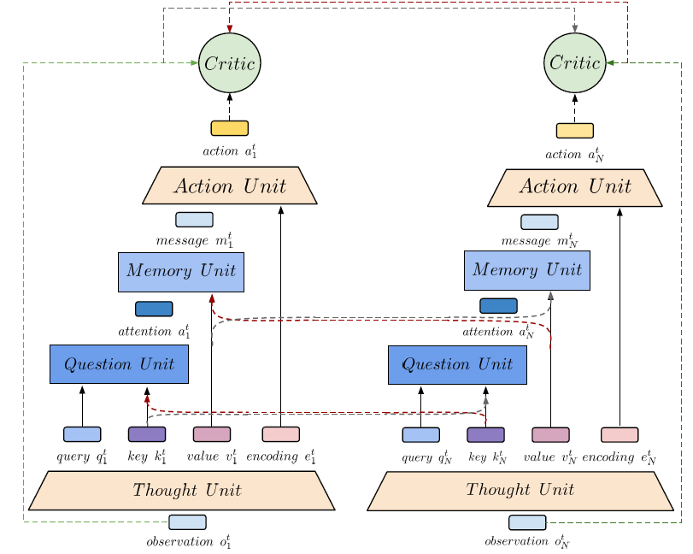
相关工作
Attentive Reasoning
Intuition
learning which communicated information is beneficial for each agent’s decision-making process remains a challenging task.
Structured Attentive Reasoning Network
Thought Unit: encodes its local observations into appropriate representations
Question Unit: generate the importance of all information communicated
Memory Unit & Action Unit
Murtaza Rangwala. Learning Multi-Agent Communication through Structured Attentive Reasoning. NIPS-20.

Slide 21
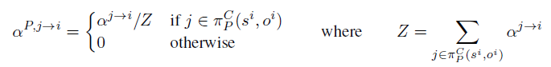
相关工作
Programmatic Communication Policies
Intuition
Inferring communication structures that can solve cooperative multi-agent planning problems while minimizing the amount of communication.
Neurosymbolic Transformer Policies
Oracle Policy: based on the transformer architecture
Programmatic Communication Policies:
Combined Transformer & Programmatic Communication Policies:
Jeevana Priya Inala. Neurosymbolic Transformers for Multi-Agent Communication. NIPS-20.

Slide 22
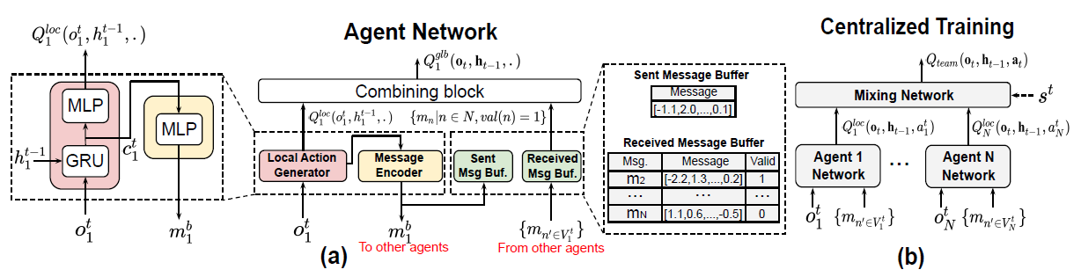
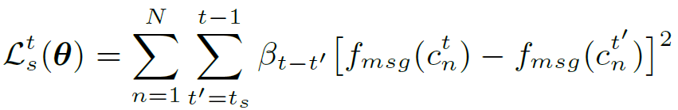
相关工作
Temporal Message
Intuition
Existing communication schemes often require agents to exchange an excessive number of messages at run-time under a reliable communication channel, which hinders its practicality in many real-world situations.
Temporal Message Control
Sai Qian Zhang. Succinct and Robust Multi-Agent Communication With Temporal Message Control. NIPS-20.

Slide 23
目录
背景介绍
相关工作
目前思路

Slide 24
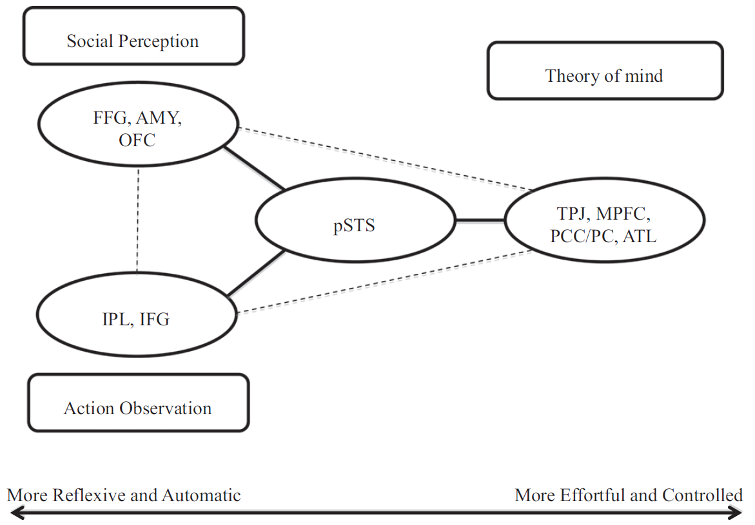
目前思路
Theory of Mind
Social Perception
The ability to decode another person’s mental states based on basic behavioral signals.
Action Observation
The perceiver may try to understand what the actions would mean if they themselves were to perform the same actions.
Theory of Mind
The ability to infer other persons’ mental states and emotions.
Daniel Y.-J. Yang. An integrative neural model of social perception, action observation, and theory of mind. Neuroscience and Biobehavioral Reviews.
Notes:
作为社会信息处理基础的三个关键神经系统的神经基础：社会感知、行为观察和心理理论
在猴子身上可以观察到类似的社会行为，因此，初级研究可以作为理解人类社会认知的有用模型。例如，黑猩猩和科维德人能够理解同种动物在食物竞争中的知识.
有趣的是，chim panzees还可以利用他人意图的信息来帮助同种动物和人类（Melis等人，2011年），有证据表明恒河猴能够根据他人所能看到和听到的推断出他人的想法（Flombaum和Santos，2005年）
我们将相应的神经系统称为行为观察或理解，其中社会相关的行为理解要求感知者超越单纯的解码，努力将自己的行为与观察到的行为成功匹配（Williams et al.，2001，2004）。为了理解他人的行为，感知者必须首先观察到该行为，然后在心理上对其进行模仿。这样，行动观察与模仿（Dijksterhuis和Bargh，2001）和观察学习密切相关

Slide 25
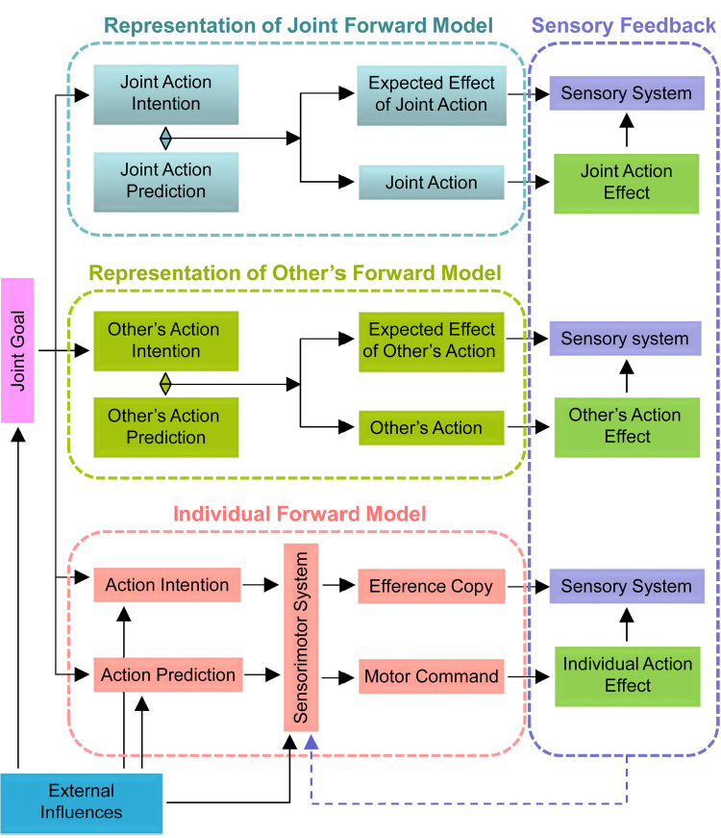
目前思路
Theory of Mind
Forward model for interpersonal action coordination
Joint action: The demands of social interaction, such as coordinating one’s own actions with those of others.
Abilities: share representations; predict actions; integrate predicted effects of own and others’ actions
Three-layered model: individual; other’s; joint
Viktor Müller. Interactive brains, social minds: Neural and physiological mechanisms of interpersonal action coordination. Neuroscience and Biobehavioral Reviews.
Notes:
联合行动需要协调人们在空间和时间上的个人行动（Vesper等人，2013年）。这通常需要在网上快速发生——因此，基于对合作伙伴完成行动的观察做出反应似乎不够充分（Knoblich和Jordan，2003年；Vesper，2014年）。相反，建议个人预测互动伙伴的行为和相应的后果.因此，人们可以根据这些预测调整自己的行为，这有助于快速准确地进行人际协调
为了达到共同的行动目标，联合行动通常要求人们积极修改自己的行动（Vesper，2014；Vesper等人，2010）。因此，联合行动不仅需要整合自己和他人的行动（Novenbre等人，2014年），还需要预测其他人将要做什么（Knoblich和Jordan，2003年）。
这种预期过程促进了联合行动，因为它们使个人能够根据对对方下一步行动的预测来计划和执行自己的行动.因此，在联合行动中，人们需要理解他人正在做什么，并预测他人将要做什么.
我们假设联合行动的正向模型是三层的。基于共同目标，每个人都拥有自己的前进模型、交互伙伴前进模型的表示以及共享或联合前进模型的表示.
基于联合目标并考虑外部影响，形成个体行为意向和相应的行为预测。这些信息流通过感觉运动系统进行整合，该系统应用动作执行的运动命令和运动命令的有效副本来比较动作执行的感觉后果。随后，在感觉系统中比较实际和预测的动作效果，以适应进一步的动作
在第二层中，个体持有另一方正向模型的表示。基于运动模拟，个体能够预测互动伙伴任务的后果（参见Vesper等人，2013年；Wolpert等人，2003年）。考虑并整合另一方的行动意图和预测，以便提供关于另一方行动预期和实际效果的感官后果的信息。互动伙伴的预测行为和实际行为之间的比较有助于个体根据互动伙伴的行为调整自己的行为
第三层，表示个人对关节向前模型的表示。在这里，考虑并整合联合行动意图和预测，以提供有关预期的感官后果以及联合行动的实际效果的信息。预测和实际联合行动结果的比较可以帮助个人改善协调。最后，如果实现了目标或以适当的方式纠正了正向模型以实现预期结果或共同目标，则在所有三层上进行的比较结果（感官一致性或差异性）将终止正向模型。
然而，有理由在这里提出这样的问题：如果参与者已经在跟踪和预测他们自己和他们的互动伙伴的行为，为什么需要一个联合前进模型？在我们看来，第三层，即联合前进模型，不是两个较低层次的简单组合，而是一个共同目标和行动的表示，超过了单个表示。
让我们想象一对夫妇在舞厅里跳探戈。为了正确有效地表演探戈或任何其他舞蹈，每位舞者不仅必须能够对对方的动作做出反应，还必须预测其舞伴的动作，否则其动作将过于缓慢（参见Pickering和Garrod，2013）。此外，两个舞伴必须有一个共同的目标和意图，以及如何跳探戈的共同概念。这些共同的意图、想象和想法也应该被预测，以便有效地完成联合行动。如有必要，在采取纠正或更新所有这些正向模型的措施后，必须整合代表个人、他人和联合正向模型的所有信息流，并将其反馈给感觉运动系统

Slide 26

目前思路
StarCraft Multi-Agent Challenge
Micromanagement Challenges
each unit be controlled by an independent agent that conditions only on local observations restricted to a limited field of view centred on that unit.
Mikayel Samvelyan. The StarCraft Multi-Agent Challenge. NIPS-19.
Notes:
为了构建一个丰富的多代理测试平台，我们只关注微观管理。微操是星际争霸游戏的一个重要方面，有着很高的技能上限，业余和专业玩家都可以单独练习微操。对于SMAC，我们利用了微观管理的自然多代理结构，提出了专门为分散控制设计的问题的修改版本。特别是，我们要求每个单元由一个独立的代理控制，该代理仅根据局限于以该单元为中心的有限视野内的局部观测条件（见图2）。这些代理的团队必须接受训练，以解决具有挑战性的战斗场景，在游戏内置脚本AI的集中控制下与敌对军队作战。
战斗中适当的单位微操可以最大限度地提高对敌人单位的伤害，同时最大限度地减少受到的伤害，并且需要一定的技能。例如，一项重要的技术是集中火力，即命令部队联合攻击和杀死一个接一个的敌军单位。当集中火力时，避免过度杀戮是很重要的：对单位造成比杀戮所需的伤害更大的伤害。
其他常见的微技术包括：根据装甲类型将部队集结成编队，让敌军部队在保持足够距离的同时进行追击，以确保几乎不会造成伤害（风筝），协调部队的位置从不同方向发起攻击，或利用地形击败敌军。图1b显示了三个跟踪者单位如何将五个敌方狂热者单位放在风筝上。

Slide 27
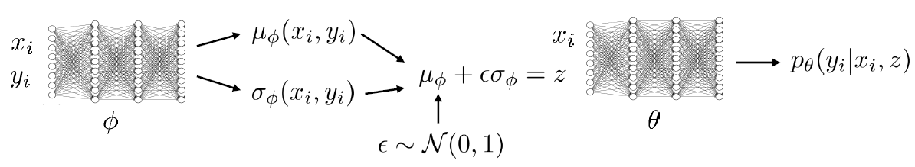
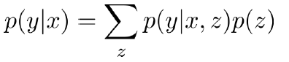
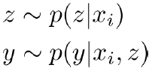
目前思路
How to Generate Intention
predict others’actions
Conditional Latent Variable Model
Maximizing ELBO = Minimizing KL-divergence
At test time:
mimic the actions
Short-term & Long-term
Para-Share
Notes:
understanding and subsequently mimicking the actions of others, that is, action observation via the mirror neuron system(Iacoboni et al., 2001; Iacoboni and Dapretto, 2006), as well as predicting others’ actions and taking another person’s perspective in the environment

Slide 28
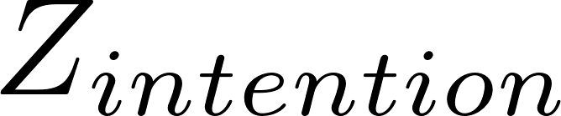
目前思路
How to Train Intention
Training
For training, sample intention = from the encoder, q(z | A_{t}, A_{t+1}), and then optimize the ELBO:
Executing
During execution, sample from the prior, p(z | A_{t})
maximum likelihood
KL-divergence between Encoder and Prior
Notes:
understanding and subsequently mimicking the actions of others, that is, action observation via the mirror neuron system(Iacoboni et al., 2001; Iacoboni and Dapretto, 2006), as well as predicting others’ actions and taking another person’s perspective in the environment

Slide 29
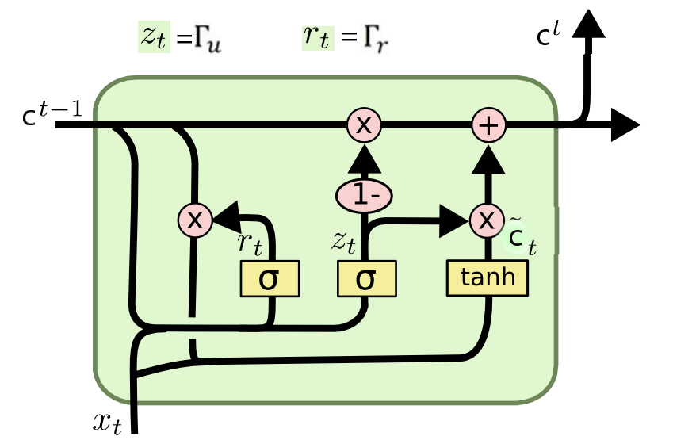

目前思路
How to Train Intention
observation_features
own_intention
Observation
GRU
MLP
Action History
Intention_E
Action’_{t+1}
Encoder
Action_{t}, Action_{t+1}
Prior
Action_{t}
Intention_P
Notes:
understanding and subsequently mimicking the actions of others, that is, action observation via the mirror neuron system(Iacoboni et al., 2001; Iacoboni and Dapretto, 2006), as well as predicting others’ actions and taking another person’s perspective in the environment

Slide 30
目前思路
How to Train Intention
Short-term & Long-term / Intention-Clip / Soft-update
In order to learn more stable intention, we eliminate the disturbance action. Besides, the opponent may make fake actions in a short time (contrary to the long-term intention). Therefore, in order to be robust, we establish a short-term intention to eliminate fake actions.
Action History
Long-term
Intention_L
Action_{t}, Action_{t+1}
Para-Share
Short-term
Intention_S
Action_{t}, Action_{t+1} , Action_{t+2}
Notes:
understanding and subsequently mimicking the actions of others, that is, action observation via the mirror neuron system(Iacoboni et al., 2001; Iacoboni and Dapretto, 2006), as well as predicting others’ actions and taking another person’s perspective in the environment

Slide 31
目前思路
How to Integrate Intention
Coordination (Attention) Two ways
It is crucial for learning an optimal coordinated policy in unknown multi-agent environments to analyze the agent’s roles and the correlation between individual agents:
Causal Inference
Wasserstein Distance
Positive correlation: W < δ
Negative correlation: W > δ
Weak correlation: ζ < W < δ
Strong correlation: W < ζ
There is some connection between the two ways!
Notes:
understanding and subsequently mimicking the actions of others, that is, action observation via the mirror neuron system(Iacoboni et al., 2001; Iacoboni and Dapretto, 2006), as well as predicting others’ actions and taking another person’s perspective in the environment

Slide 32
目前思路
How to Integrate Intention
Generate Action
Integrate the Intention of Strong Correlation agents
Remain Question:
At the beginning, the intentions of other agents are random, which will make the current agent unable to obtain useful information
So we can pre-train agents independently before implementing our algo.
Notes:
understanding and subsequently mimicking the actions of others, that is, action observation via the mirror neuron system(Iacoboni et al., 2001; Iacoboni and Dapretto, 2006), as well as predicting others’ actions and taking another person’s perspective in the environment

Slide 33
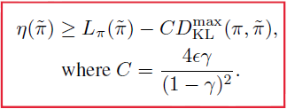
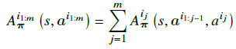
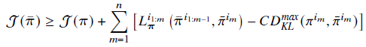
目前思路
How to Integrate Intention
Trust Region Policy Optimization
TRPO for Multi-Agent
Multi-Agent Advantage Decomposition
Update single agent
any
positive update will lead to an increment in summation

Slide 34
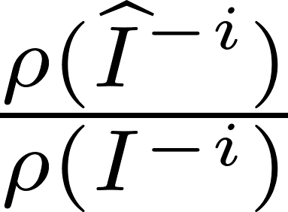
目前思路
How to Integrate Intention
With MAPPO

Slide 35
Thanks

